Slide 1

Introduction to
Machine Learning
Venelin Valkov
Plovdiv University
2018

Slide 2
Acknowledgements
These slides are heavily based on the excellent course “Deep Learning Zero to All”
by Sung Kim
https://github.com/hunkim

Slide 3


Slide 4
What are machines up to?

Slide 5
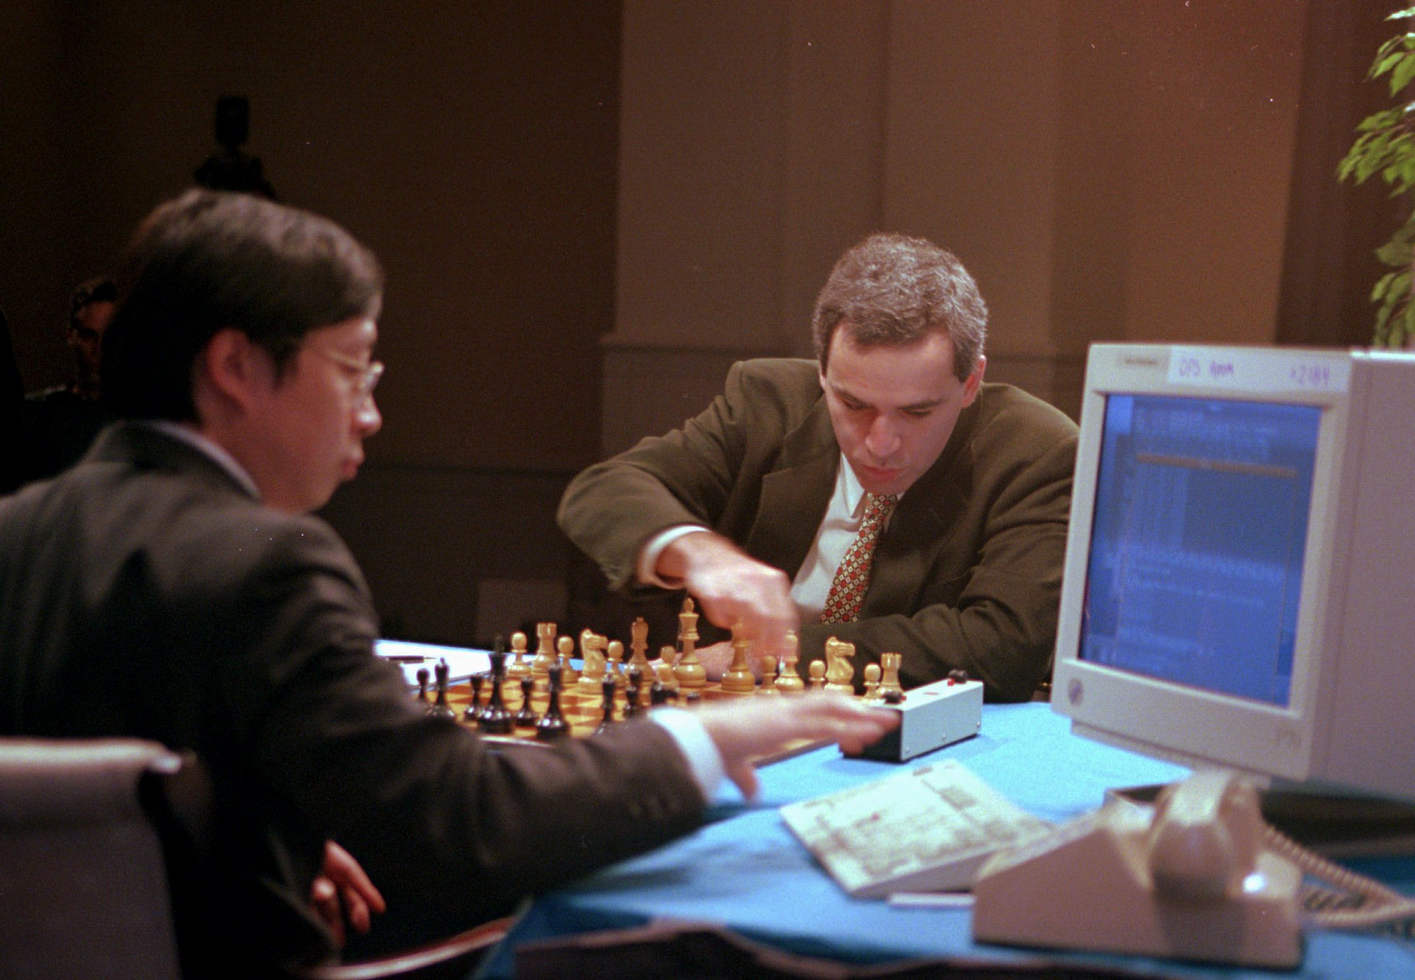

Slide 6
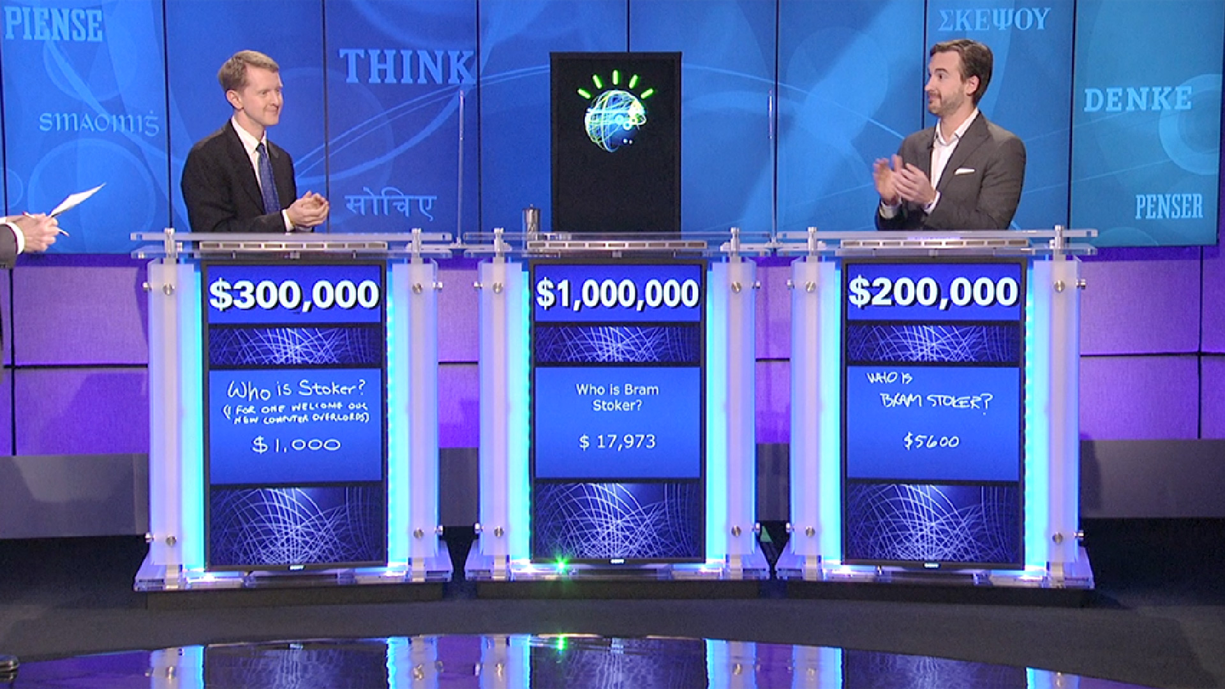

Slide 7
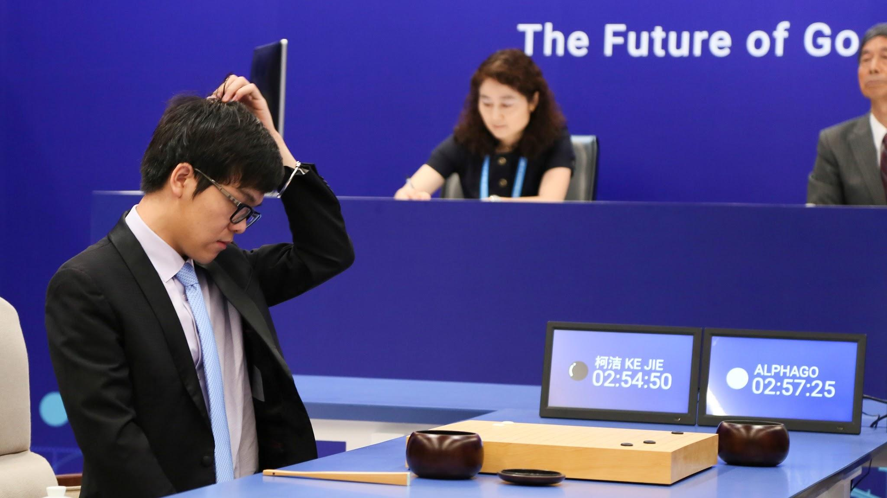

Slide 8
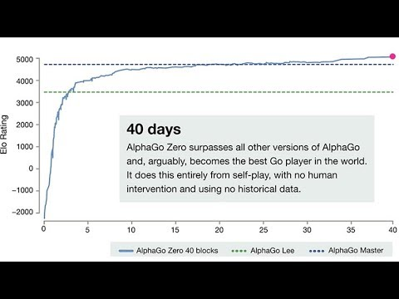
From scratch

Slide 9
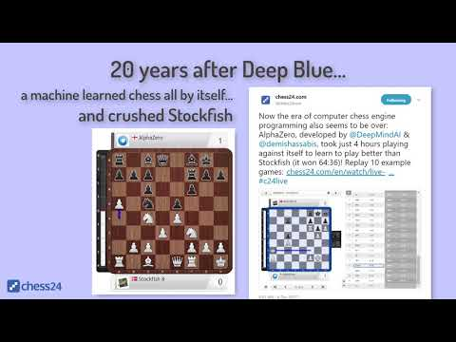
Stockfish crushed!?

Slide 10
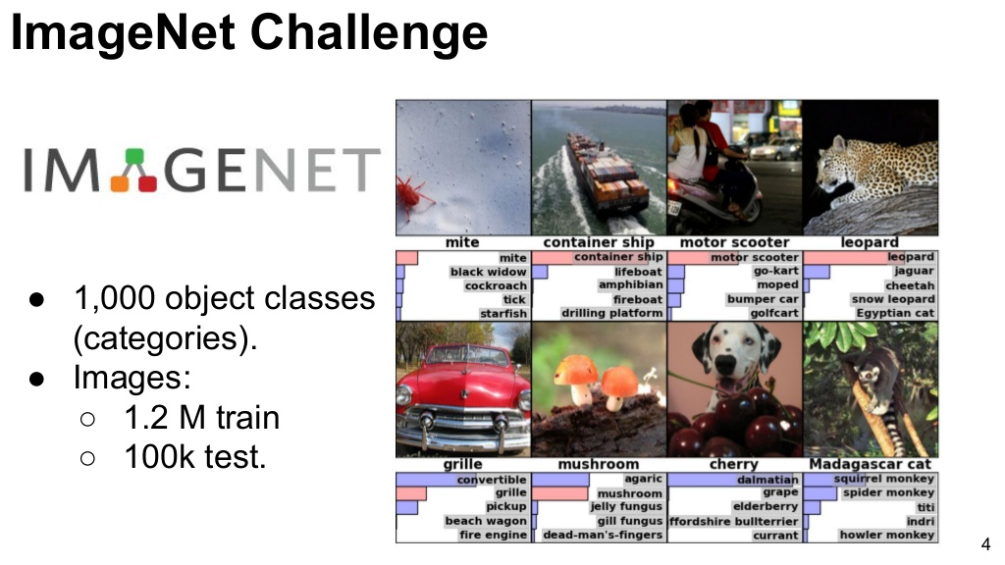
Image Understanding

Slide 11
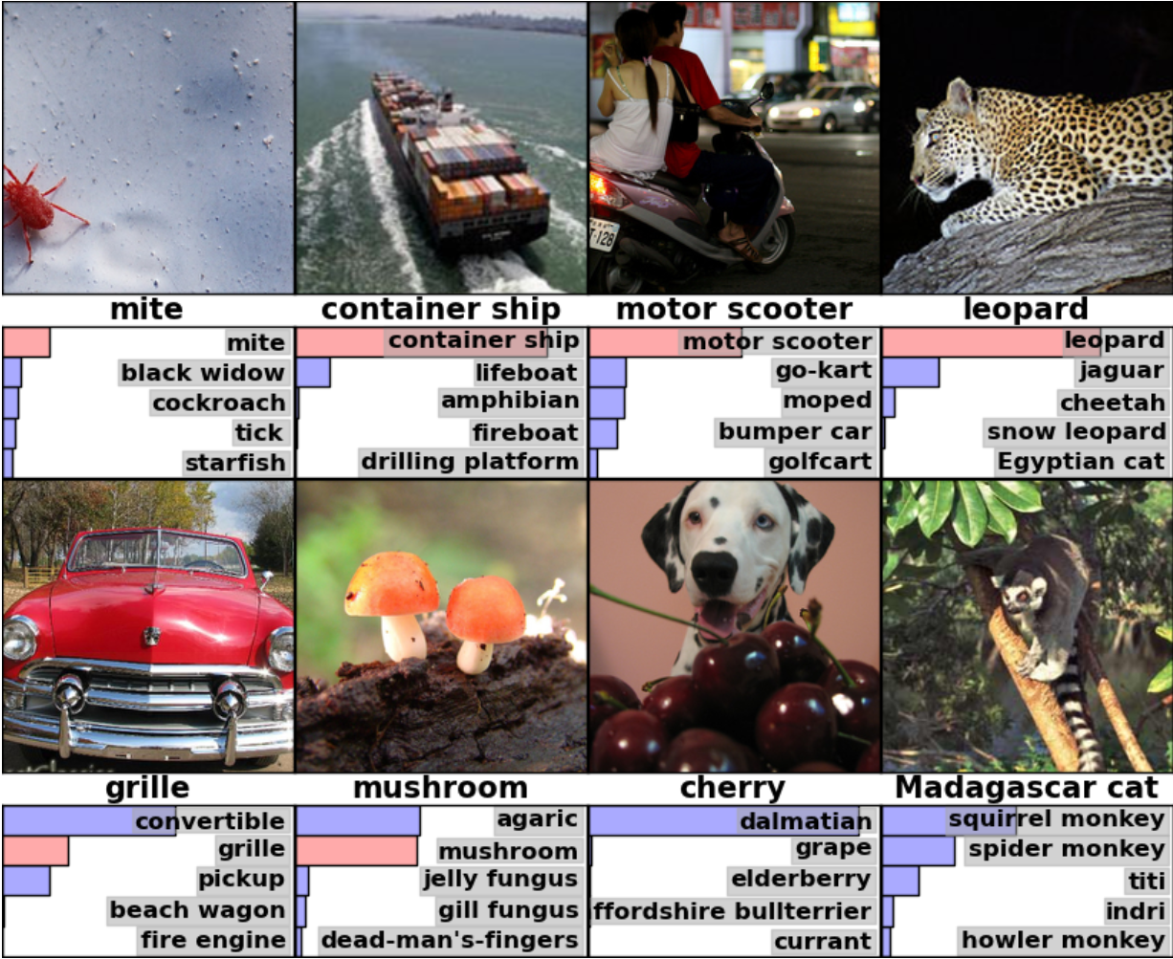

Slide 12
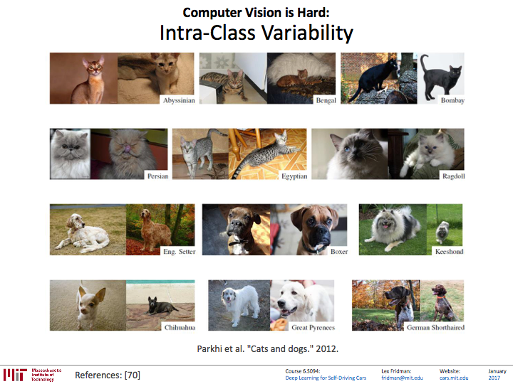

Slide 13
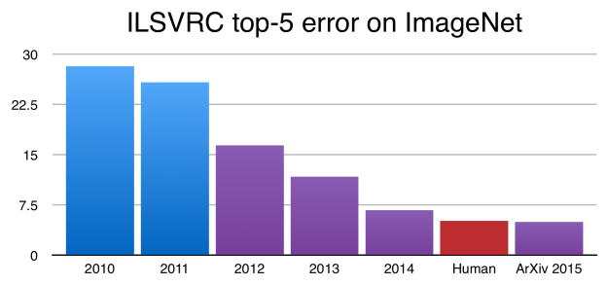
https://devblogs.nvidia.com/parallelforall/page/5/

Slide 14
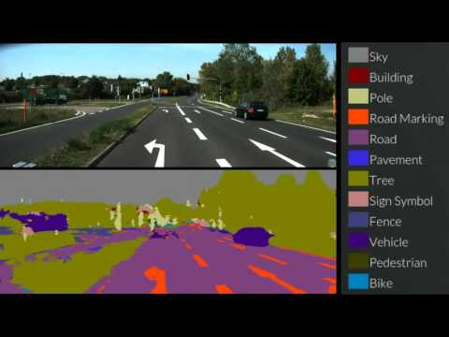
Self Driving Cars

Slide 15
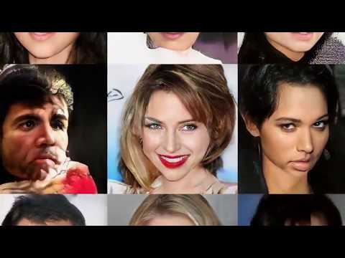
Generating Faces

Slide 16

Generating Code

Slide 17
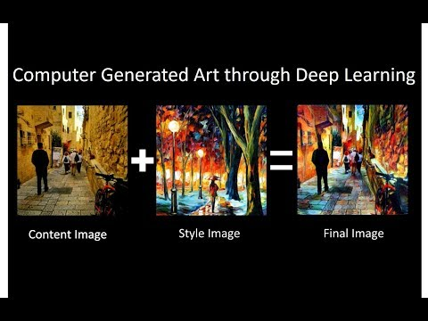
Style Transfer

Slide 18
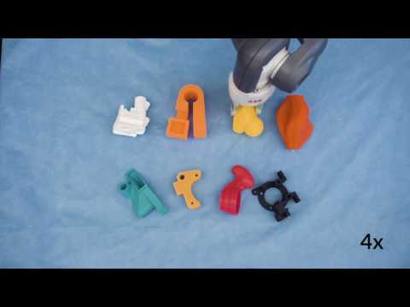
Grasping

Slide 19
Is ML really useful?

Slide 20
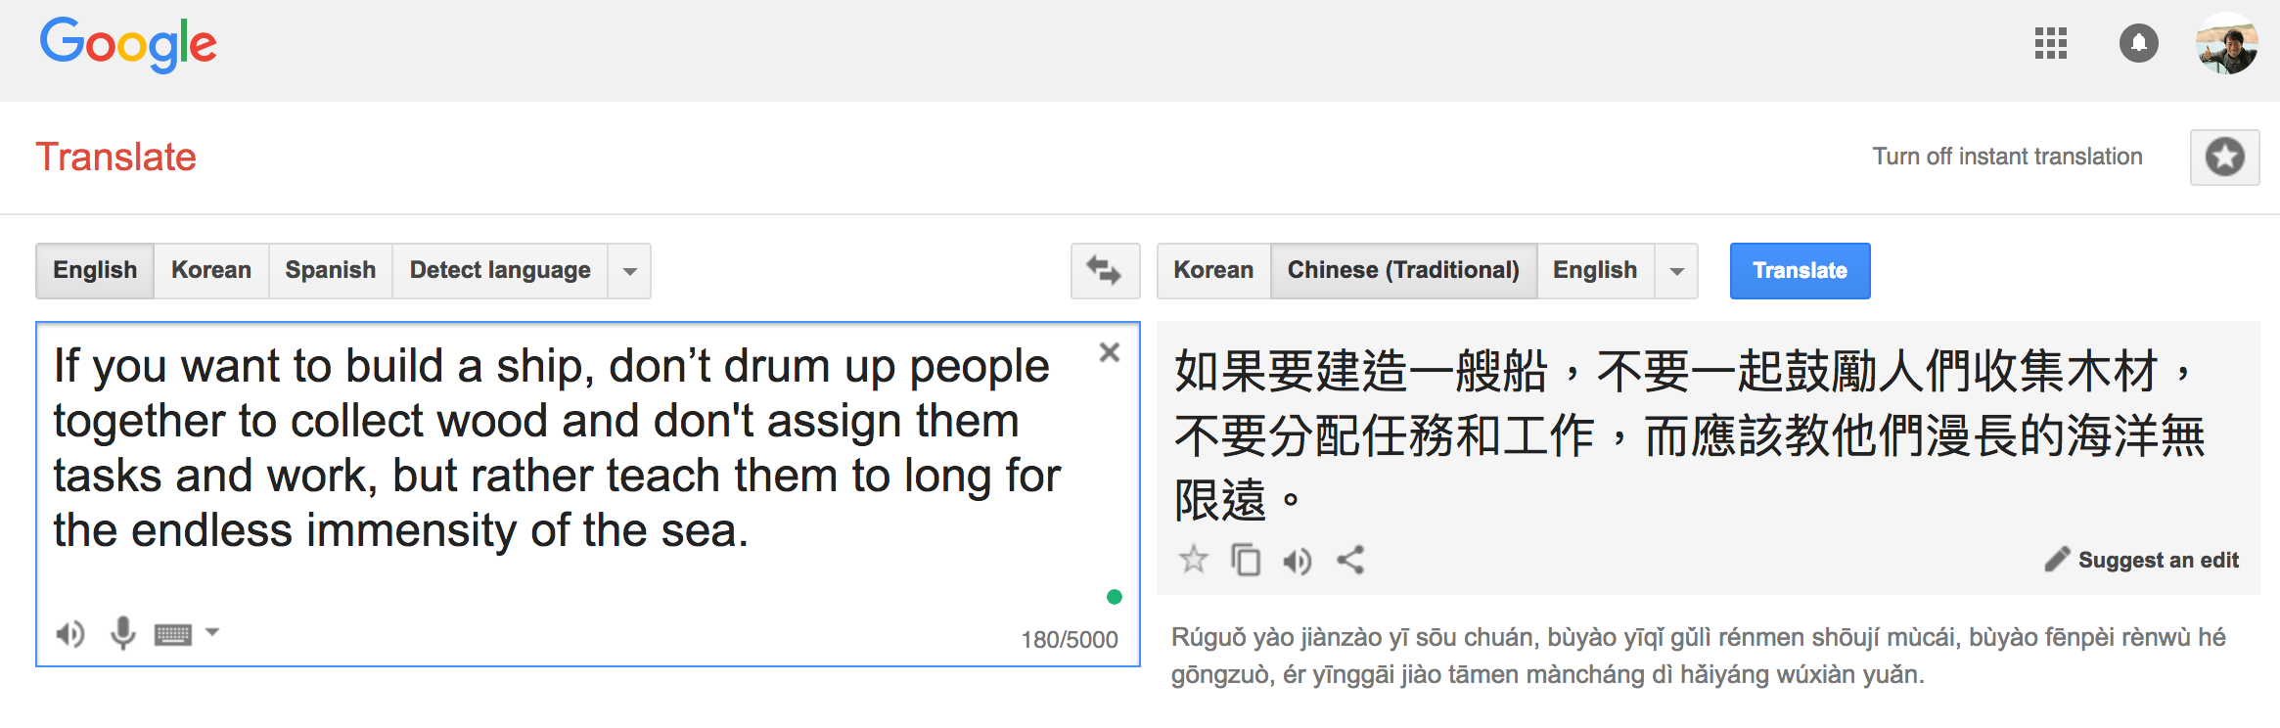

Slide 21
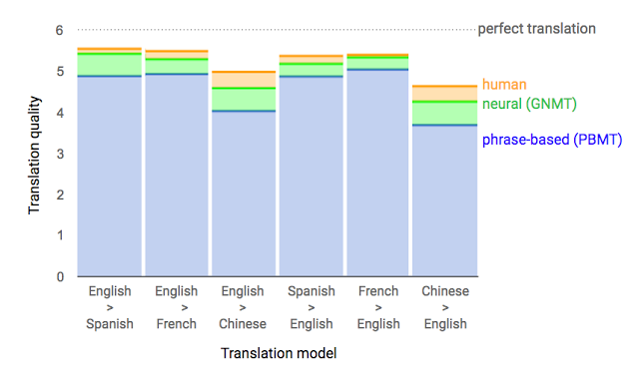
Google Neural Machine Translation (Sep 2016)
[Reference] "A Neural Network for Machine Translation, at Production Scale", https://research.googleblog.com/2016/09/a-neural-network-for-machine.html

Slide 22


Slide 23
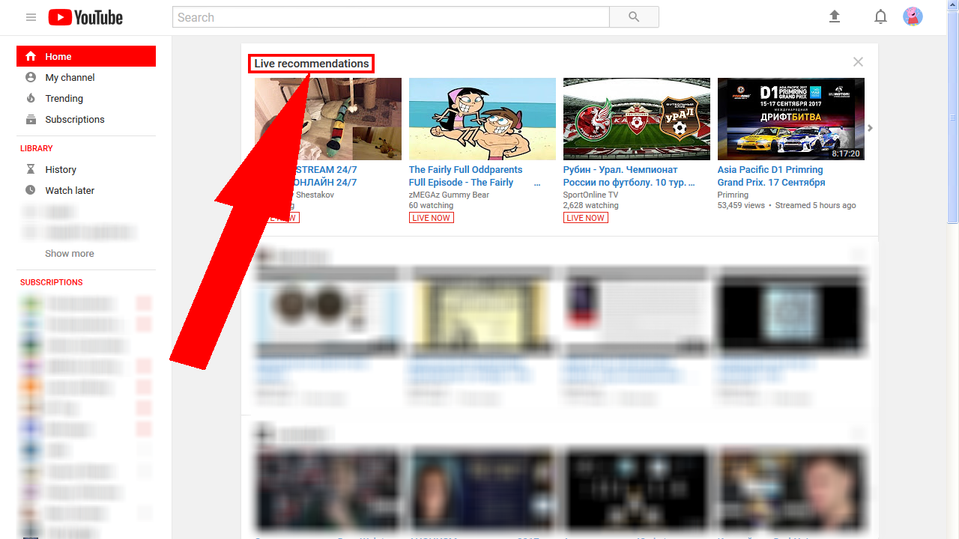

Slide 24
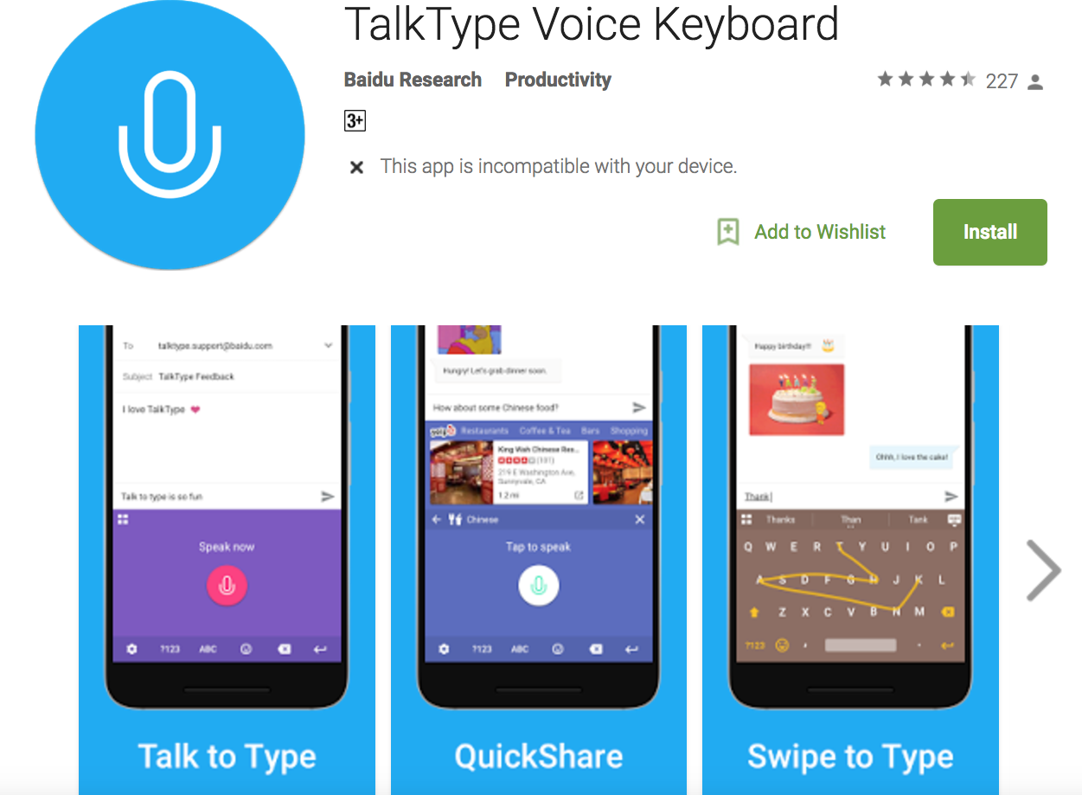
https://play.google.com/store/apps/details?id=com.baidu.research.talktype&hl=en

Slide 25
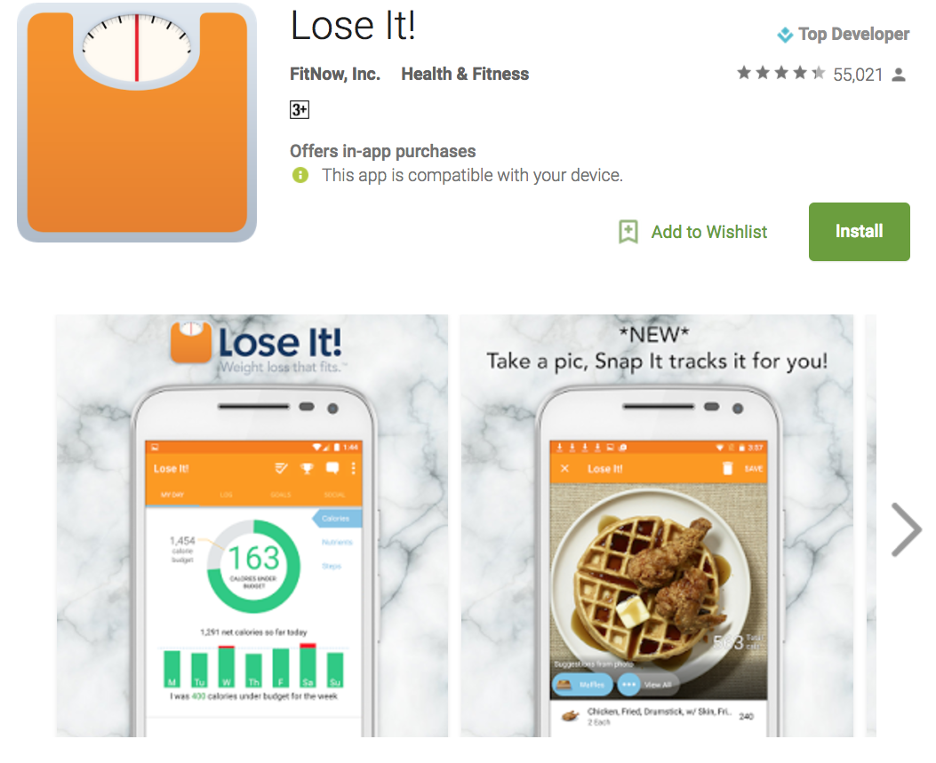
https://play.google.com/store/apps/details?id=com.fitnow.loseit&hl=en

Slide 26
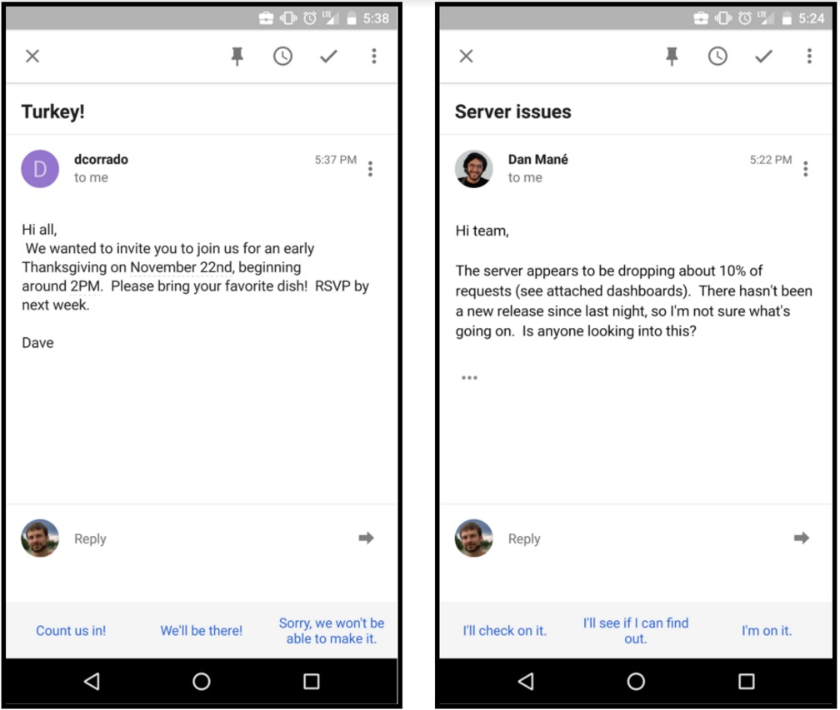
Smart Reply: Promising results
Seen 78%, Used 31.9%
http://www.kdd.org/kdd2016/papers/files/Paper_1069.pdf

Slide 27

https://www.autodraw.com/

Slide 28
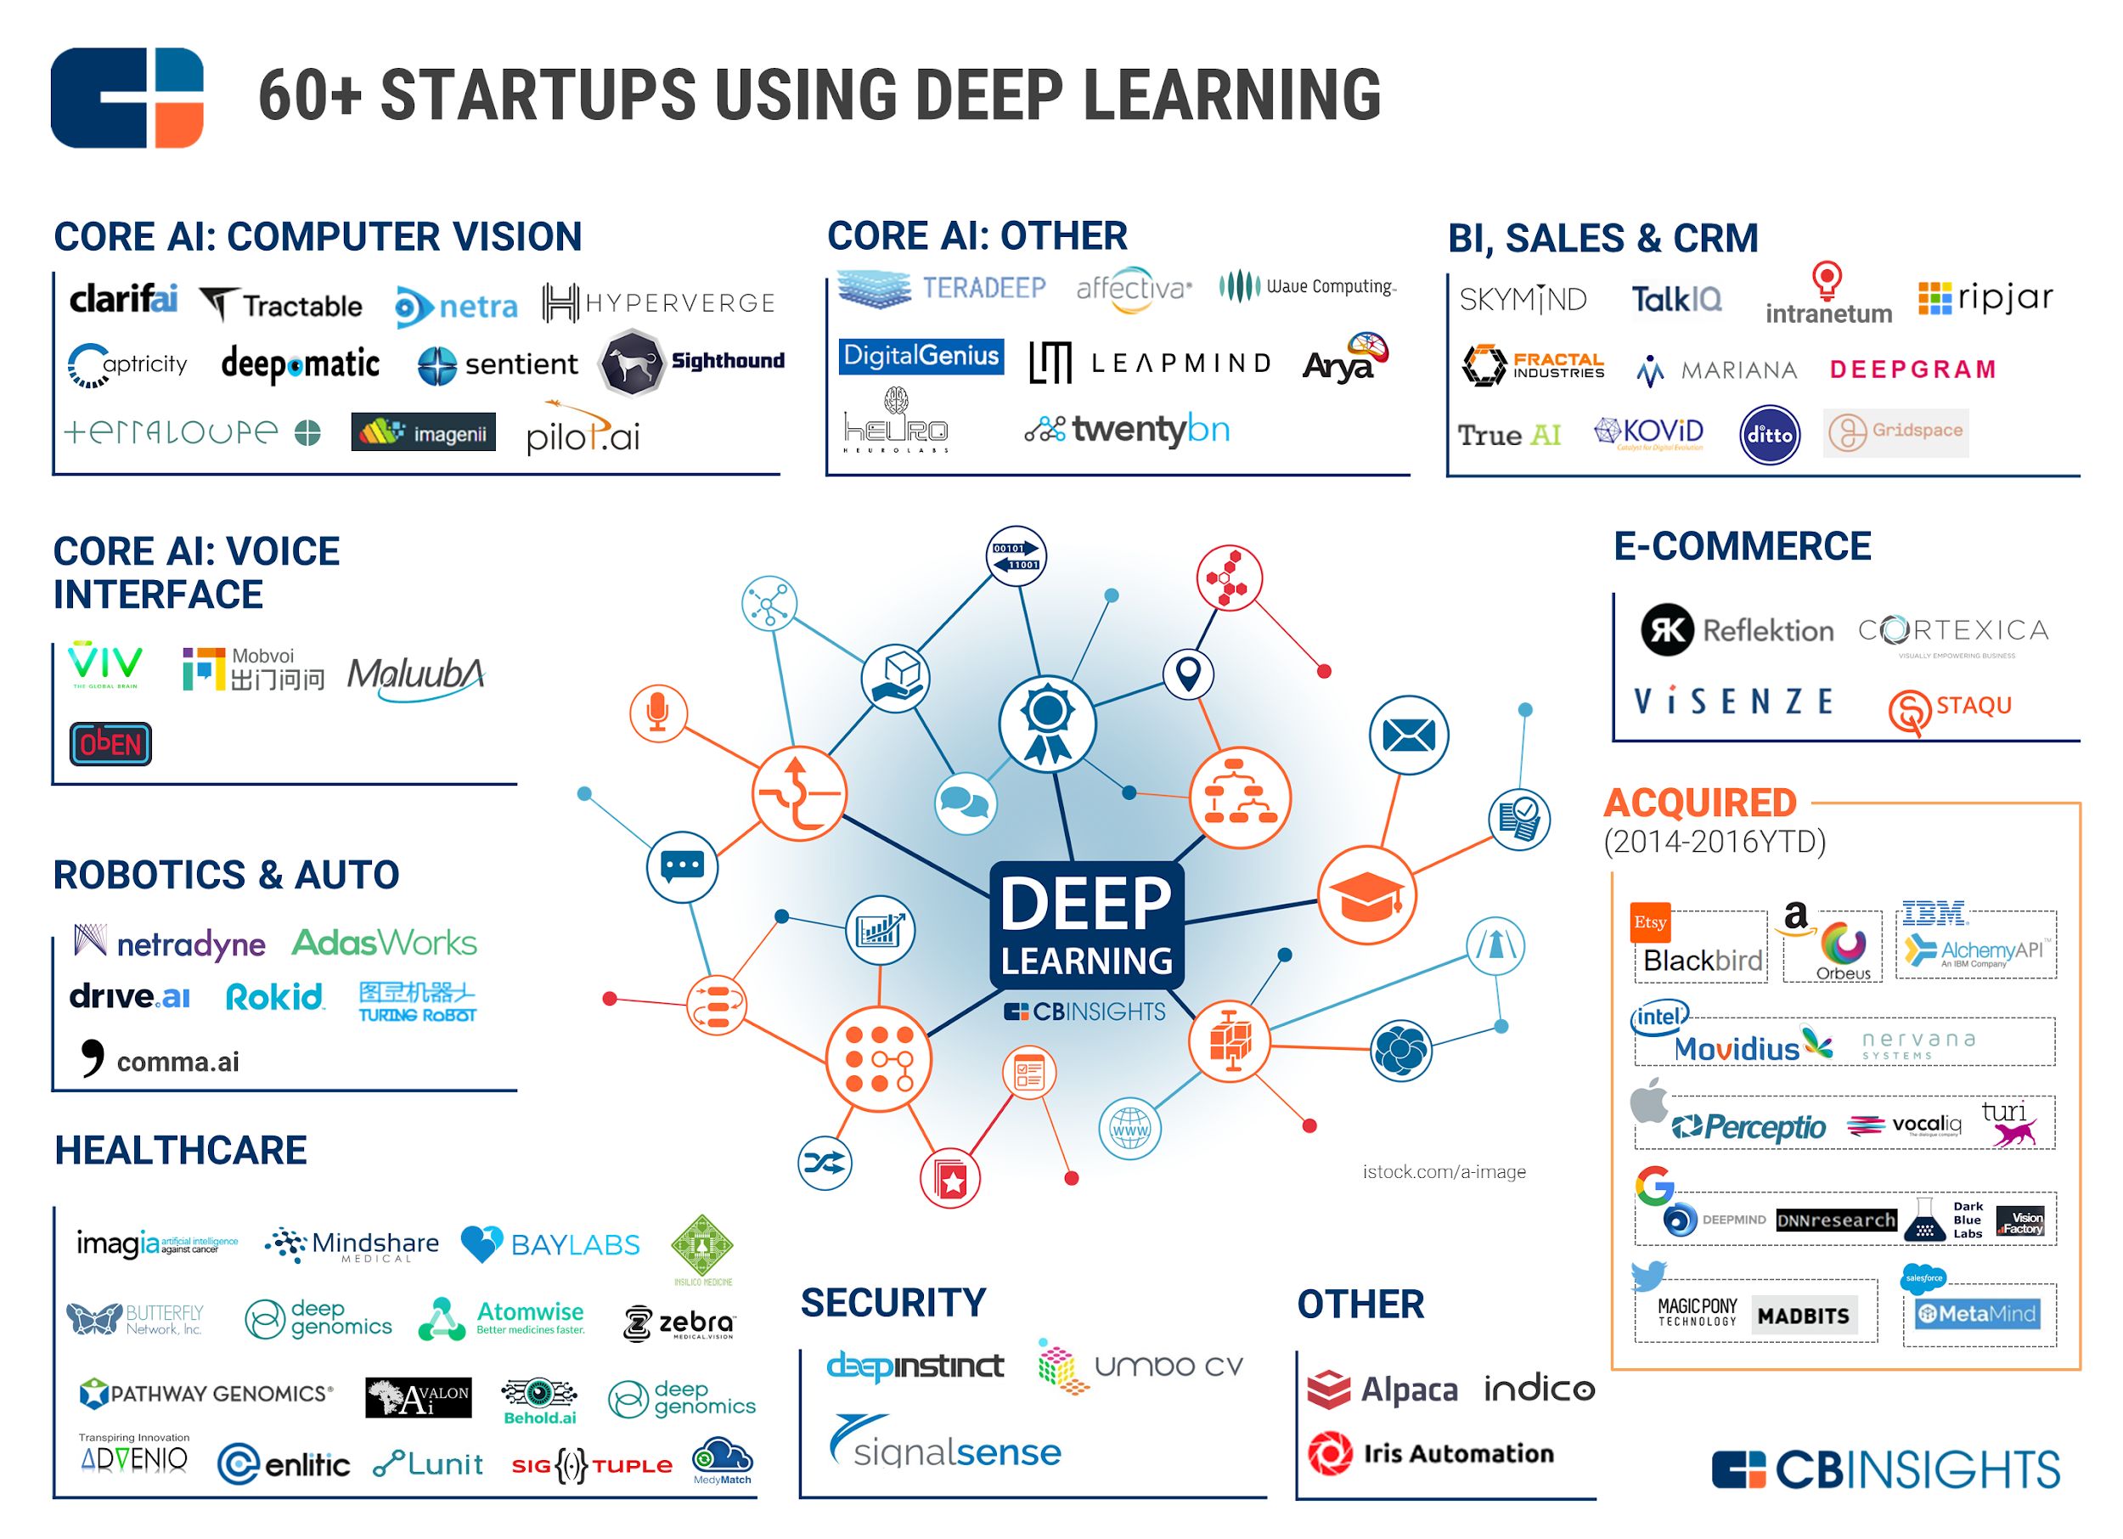
https://www.cbinsights.com/blog/deep-learning-ai-startups-market-map-company-list/

Slide 29






Slide 30
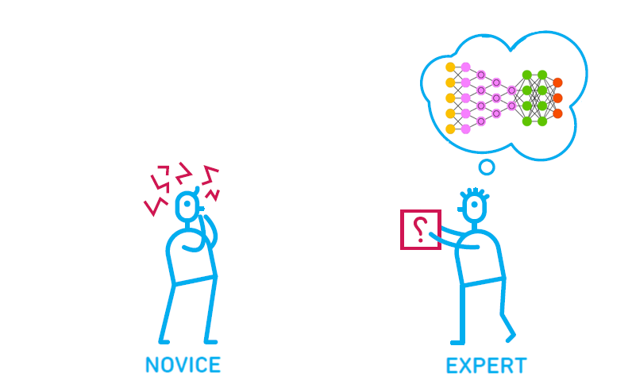
Goals
Basic understanding of machine learning/deep learning
PyTorch implementation skills
Prerequisites
Basic algebra + probability
Basic python
Adapted from Oliver Caviglioli

Slide 31
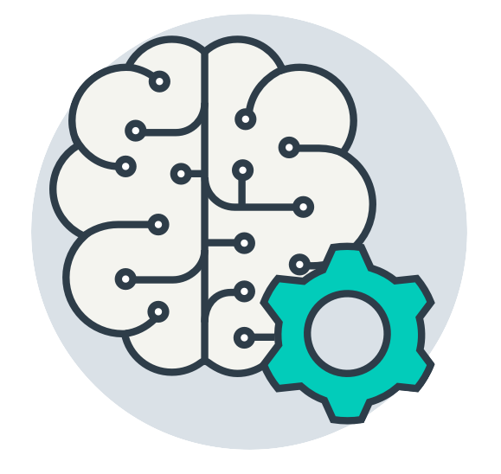
What is Machine Learning?

Slide 32

What is Human Intelligence?

Slide 33
What is Human Intelligence?
What to eat for lunch?

Slide 34

What is Human Intelligence?
What to eat for lunch?
Information

Slide 35

What is Human Intelligence?
What to eat for lunch?
Information
Infer

Slide 36
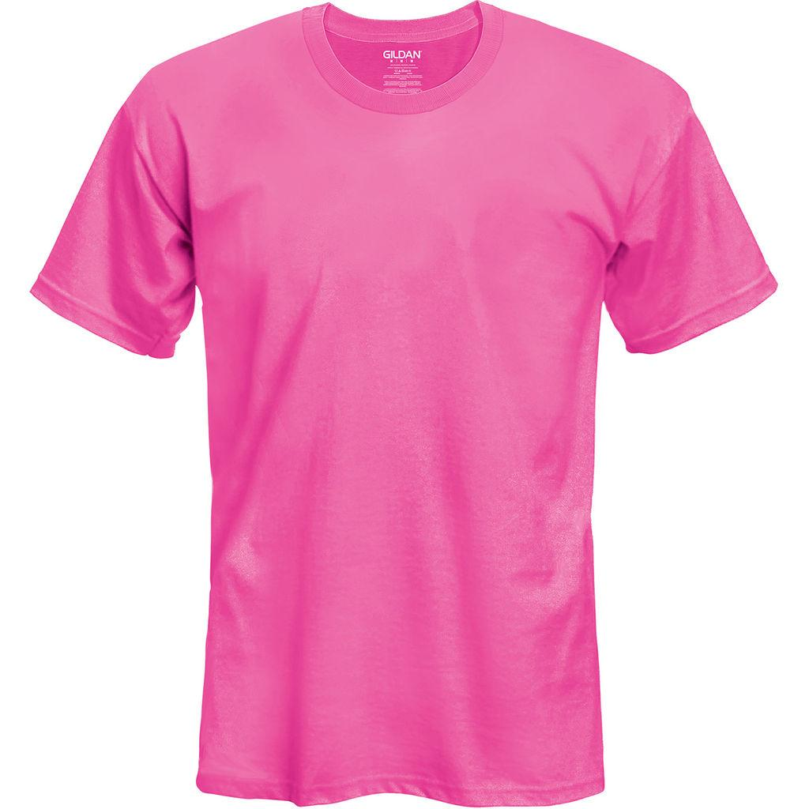
What is Human Intelligence?
What to dress?
Information
Infer

Slide 37
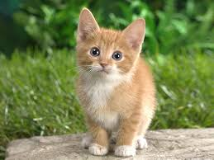
What is Human Intelligence?
What is this picture?
CAT
Image information
Prediction

Slide 38

What is Human Intelligence?
What is this number?
2
Image information
Prediction

Slide 39
What is Human Intelligence?
What would be the grade if I study 4 hours?
4 hours
? points
information
Prediction

Slide 40
Machine Learning
What would be the grade if I study 4 hours?
4 hours
? points
information
Prediction

Slide 41
Machine Learning
Machine needs lots of training
2
Image information
Prediction

Slide 42

Machine Learning
Machine needs lots of training
Model
training
Labeled dataset

Slide 43
Machine Learning
Predict (test) with trained model
Trained model

Slide 44
Machine Learning
Predict (test) with trained model
Image information
Test dataset
Trained model

Slide 45
Machine Learning
Predict (test) with trained model
2
Image information
Prediction
Test dataset
Trained model

Slide 46
Machine Learning
What would be the grade if I study 4 hours?
4 hours
? points
Prediction
Hours (x) | Points (y)
1 | 2
2 | 4
3 | 6
4 | ?
Training dataset
Test dataset

Slide 47
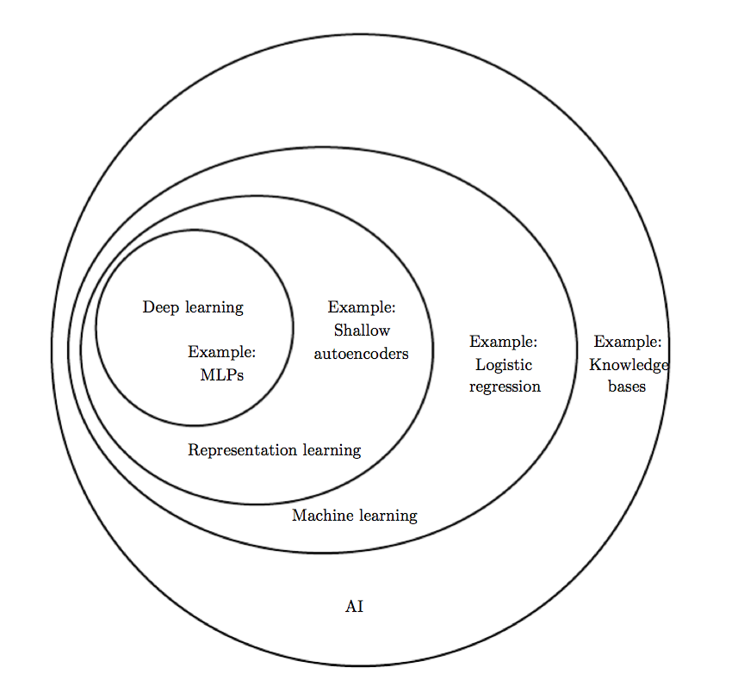
Deep Learning?
Deep Learning by Ian Goodfellow, Yoshua Bengio, Aaron Courville

Slide 48
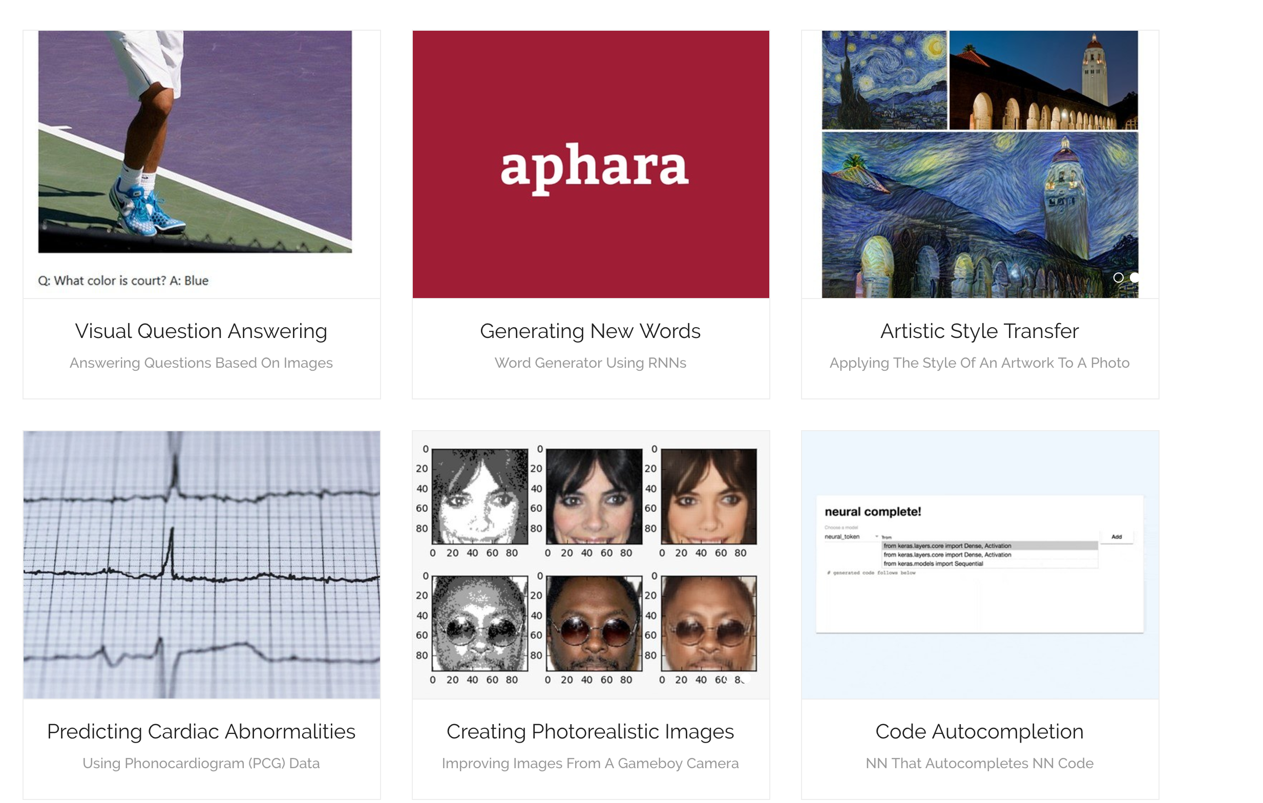
Why We Care?
More demos at https://ml-showcase.com/

Slide 49
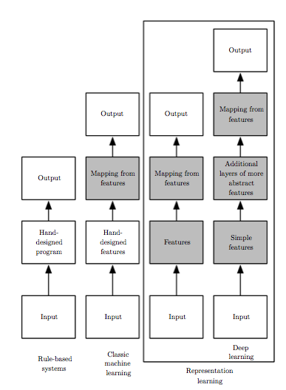
Why should you care?
Deep Learning by Ian Goodfellow, Yoshua Bengio, Aaron Courville

Slide 50
Machine Learning
Limitations of explicit programming
Spam filter: many rules
Automatic driving: too many rules
Machine learning: "Field of study that gives computers the ability to learn without being explicitly programmed” Arthur Samuel (1959)

Slide 51
Supervised/Unsupervised learning
Supervised learning:
learning with labeled examples - training set
Unsupervised learning: un-labeled data
Google news grouping
Word clustering

Slide 52
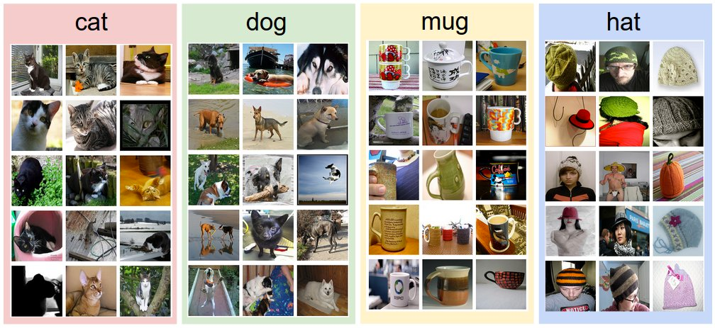
Supervised learning
An example training set for four visual categories.
http://cs231n.github.io/classificatio/

Slide 53
Supervised/Unsupervised learning
Supervised learning:
learning with labeled examples
Unsupervised learning: un-labeled data
Google news grouping
Word clustering

Slide 54
Supervised learning
Most common problem type in ML
Image labeling: learning from tagged images
Email spam filter: learning from labeled (spam or ham) email
Predicting exam score: learning from previous exam score and time spent

Slide 55
Types of supervised learning
Predicting final exam score based on time spent
regression
Pass/non-pass based on time spent
binary classification
Letter grade (A, B, C, E and F) based on time spent
multi-label classification

Slide 56
Predicting final exam score based on time spent
x (hours) | y (score)
10 | 90
9 | 80
3 | 50
2 | 30

Slide 57
Pass/non-pass based on time spent
x (hours) | y (pass/fail)
10 | P
9 | P
3 | F
2 | F

Slide 58
Grade (A, B, …) based on time spent
x (hours) | y (grade)
10 | A
9 | B
3 | D
2 | F

Slide 59

Let’s learn some Python!!!

